Slide 1
Creative Media Production management Project
FMP- Lilly Grant

Slide 2
Mind map of ideas

Slide 3
Chosen idea
Photographs help us capture memories, when somebody is looking through their dead parents' things they find a picture dated a long time back, the picture hasn't faded to black and white, pictures are always in color until the person in the photographed dies. Tyler must find answers to how this could have happened.
(Based in an alternate world where picture's are always in color until the person photographed dies.)

Slide 4
Project portfolio (research)

Slide 5
Life Is Strange is a five part episodic game that sets out to revolutionise story based choice and consequence games by allowing the player to rewind time and affect the past, present and future.

Slide 6
As a group of friends discover plans for a time machine, they build it and use it to fix their problems and for personal gain. But as the future falls apart with disasters, and each of them disappear little by little, they must travel back to the past to make sure they never invent the machine or face the destruction of humanity.

Slide 7
A 29 year old man lives a quiet and peaceful life working at a pizza place when he is experiencing a strange phenomenon he calls 'Revival'. When 'Revival' happens, Satoru Fujinuma is brought back up to 5 minutes in the past where he must prevent a tragedy from happening, like an accident. One day, he gets falsely accused of murder and the phenomenon occurs but this time, he gets back 18 years in the past which is during his middle school period. With the mind of a 29 years old adult and the body of a child, he needs to find out what he must change to revoke this accusation and get back in the present.

Slide 9
Mood Board of Shots

Slide 10
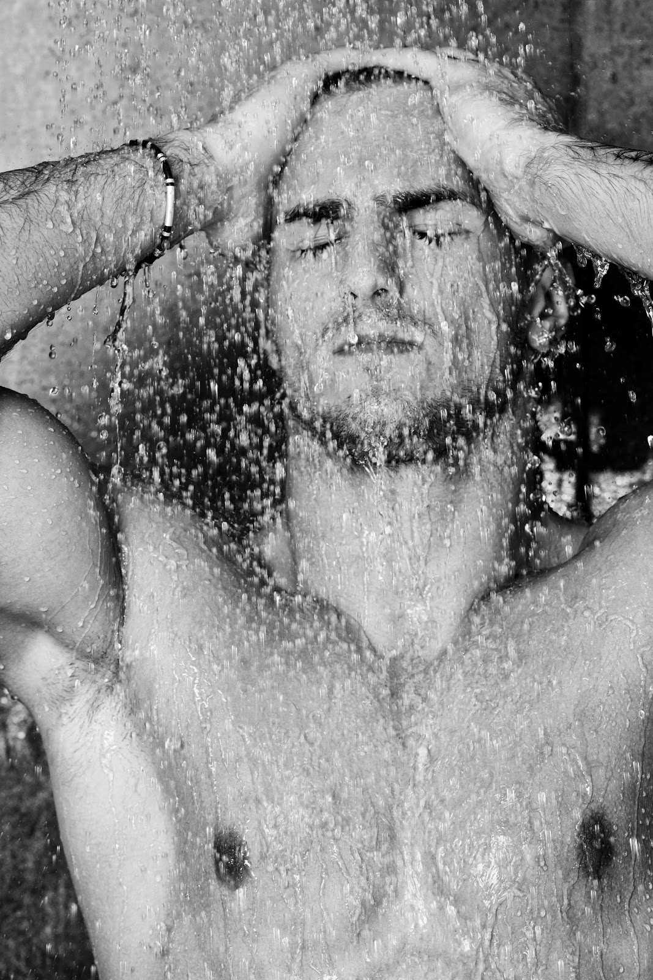
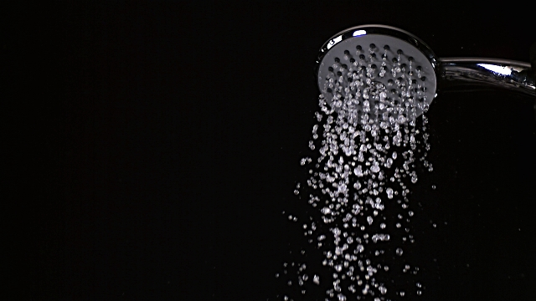
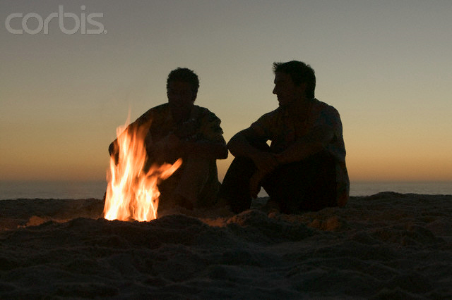
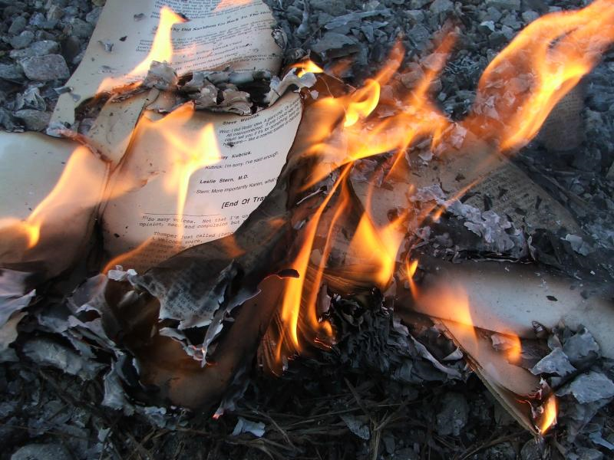
Mood board of shots

